Slide 1
DEEP LEARNING COURSE · UNIT 1
Introduction to
Deep Learning
Neural Networks · ANN · History of AI · Why Go Deep · Applications · Challenges
AI & Machine Learning Department | 10 Hours

Slide 2
COURSE MAP
What We Will Cover in Unit 1
1
2
3
Neural Networks & ANN
Why Deep Learning
Brief History of AI
What neurons, layers and networks are
How DL differs from classical ML
From Turing (1950) to Generative AI
4
5
6
Successes of the Last Decade
Reasons to Go Deep
Applications & Challenges
AlexNet, AlphaGo, ChatGPT and more
Data, compute, algorithms, features
Where DL works, and where it struggles
UNIT 1 · INTRODUCTION TO DEEP LEARNING
2

Slide 3
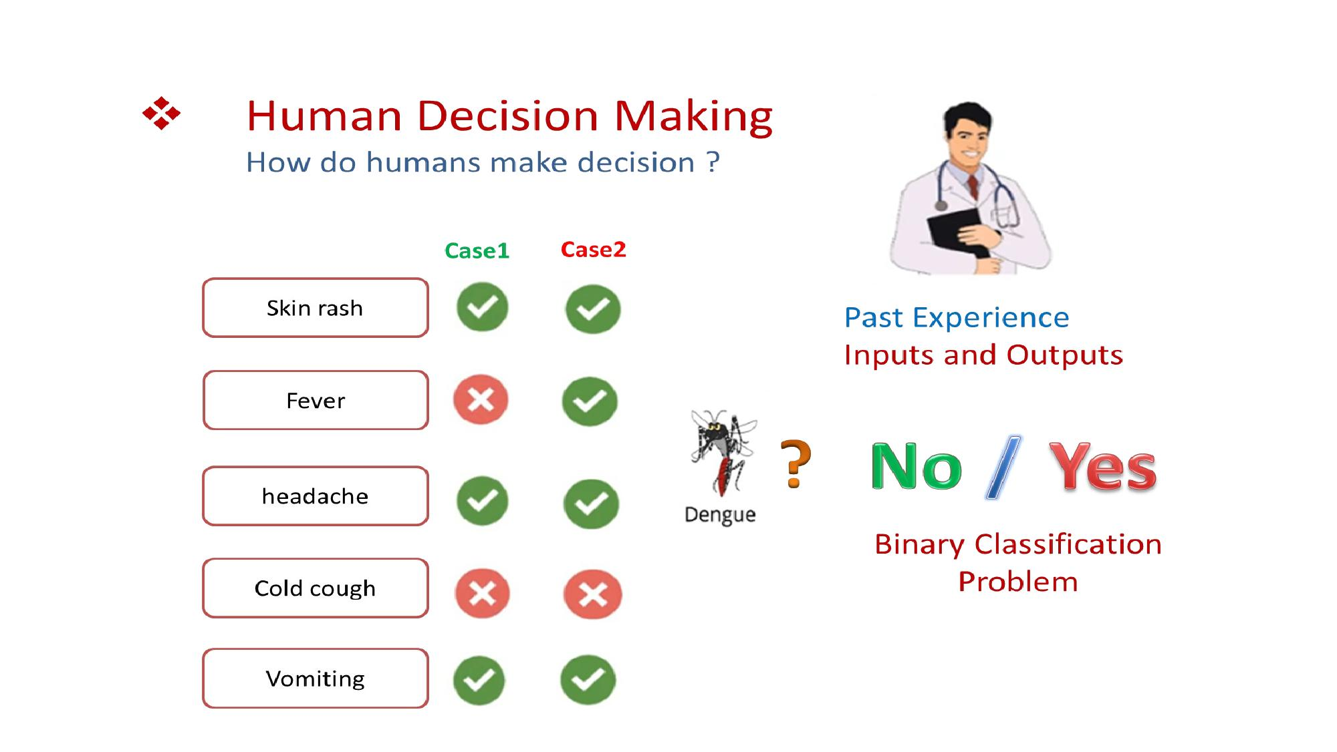
SETTING THE STAGE
How Do Humans Make Decisions?
UNIT 1 · INTRODUCTION TO DEEP LEARNING
3

Slide 4
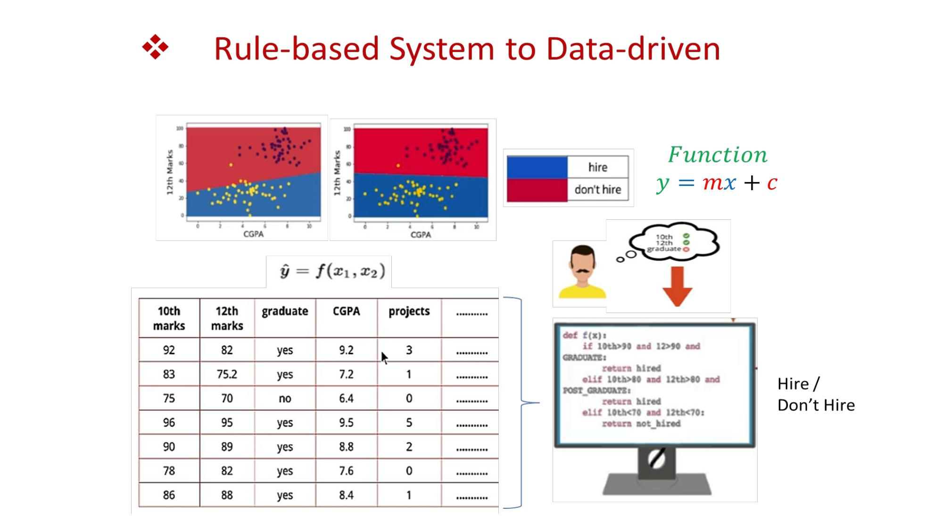
SETTING THE STAGE
From Rule-Based Systems to Data-Driven Models
UNIT 1 · INTRODUCTION TO DEEP LEARNING
4

Slide 5
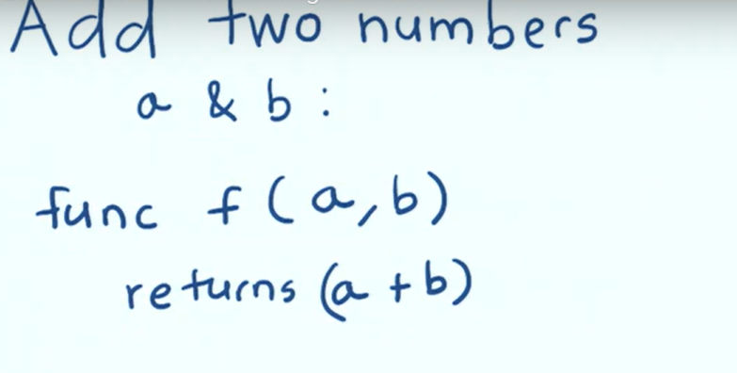
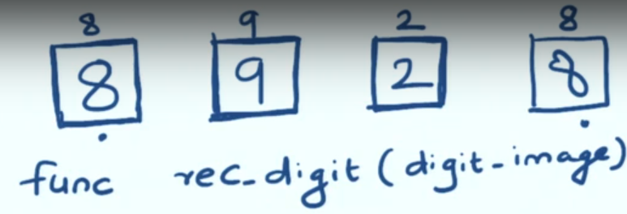
Machine & Deep Learning
Handwritten digit recognition from images
Data
Rules,
Patterns,
Models
Program
Data
Output
ML/DL
Rules
Output

Slide 6
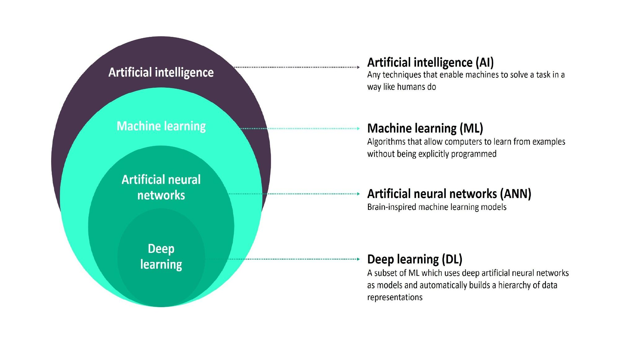
SECTION 1 · NEURAL NETWORKS
Where ANN Fits: AI → ML → ANN → Deep Learning
UNIT 1 · INTRODUCTION TO DEEP LEARNING
9

Slide 7
02
Why Deep Learning?
Automatic, hierarchical feature learning from raw data

Slide 8
SECTION 2 · WHY DEEP LEARNING
Why “Deep”? Hierarchical Feature Learning
In classical ML, a human engineer manually decides what features matter (edges, colour histograms, etc). In Deep Learning, each layer automatically learns increasingly abstract features from the raw data itself.
Raw Pixels
Edges &
Corners
Shapes &
Textures
Object
Parts
Whole
Object:
“Cat”
Layer 1 Layer 2 Layer 3 Layer 4 Output
Each successive hidden layer composes the patterns detected by the previous layer into something more abstract — this is what “deep” refers to: many stacked layers of representation.
UNIT 1 · INTRODUCTION TO DEEP LEARNING
13

Slide 9
SECTION 1 → 2 · TRANSITION
Machine Learning vs Deep Learning
Machine Learning
Learns patterns from data
Example algorithms: Decision Trees, SVM, k-NN
Limitation: Needs feature engineering (manual selection of image features)
Deep Learning
Learns features and patterns automatically from raw data
Powered by neural networks, especially Convolutional Neural Networks (CNNs) for image data
Requires large datasets and high computational power
UNIT 1 · INTRODUCTION TO DEEP LEARNING
11

Slide 10
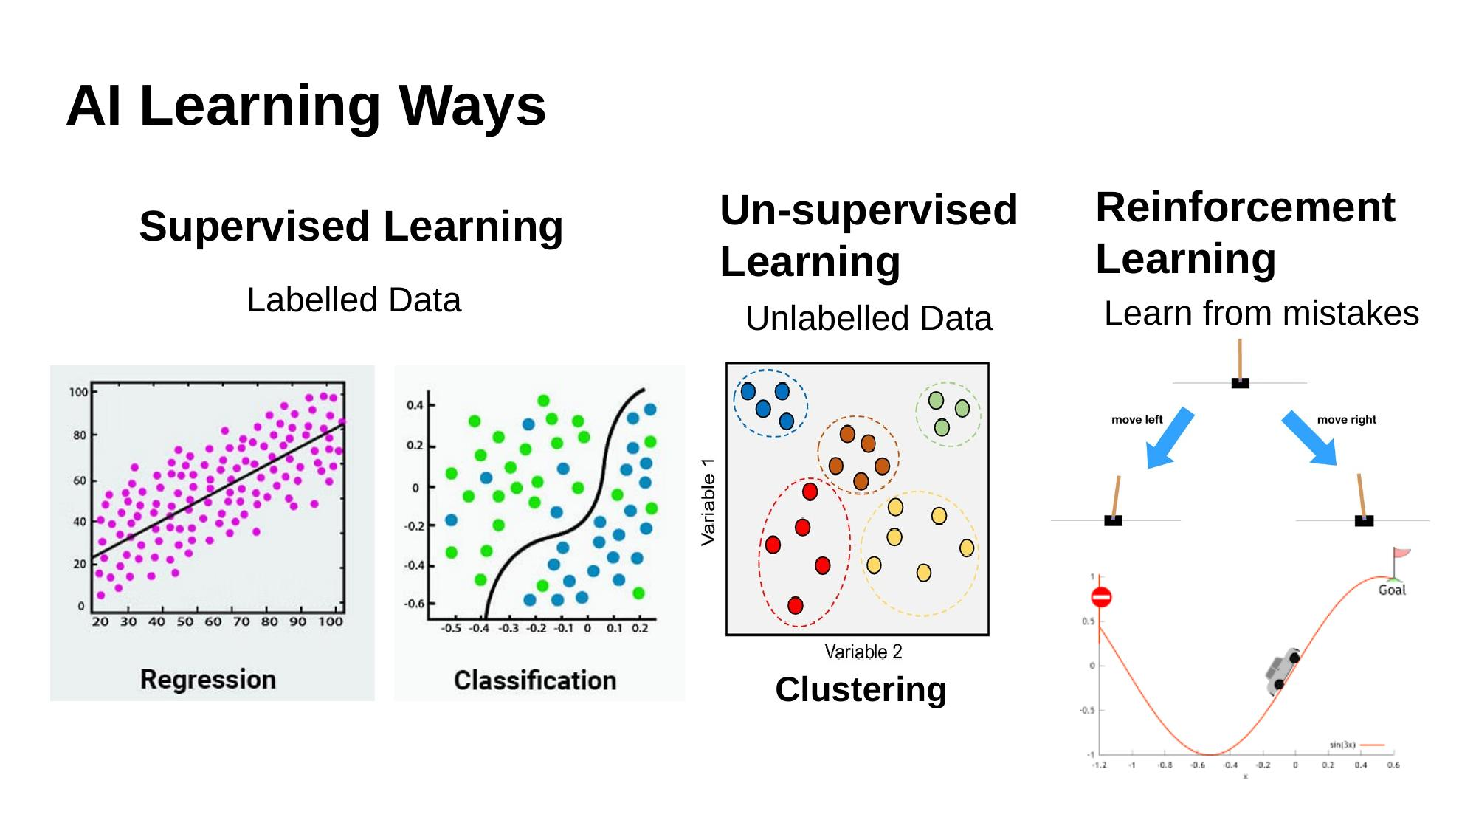
SECTION 2 · WHY DEEP LEARNING
Recap: The Three Ways Machines Learn
UNIT 1 · INTRODUCTION TO DEEP LEARNING
14

Slide 11
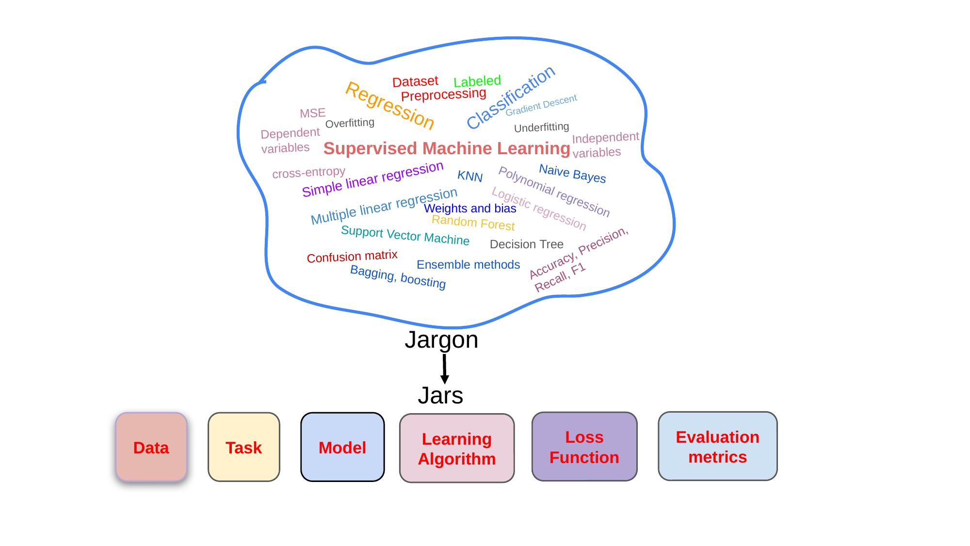
RECAP
Key Terminology Recap
UNIT 1 · INTRODUCTION TO DEEP LEARNING
27

Slide 12
General block diagram for ML/DL
Training
Train Set
I/P Dataset
Data Preprocessing
O/P Regression / Classification
Validation Set
Training and parameter tuning ML Model
Trained Model
Test Set

Slide 13
Train – Validation – Test Split
TRAIN (~64%)
VAL (~16%)
TEST (~20%)
Illustrative split — exact ratios (e.g. 80/20 train-test, with 20% of train held out for validation) vary by project.
Training Set
Validation Set
Test Set
Used to fit the model — the network's weights and biases are updated directly from this data every epoch.
Checked after every epoch, but never trained on. Used to tune hyperparameters and monitor for overfitting (e.g. via EarlyStopping).
Held out completely until the very end. Used exactly once, to report an unbiased estimate of real-world performance.
Key idea: the test set must remain completely unseen during training and tuning — otherwise, performance metrics become overly optimistic and don't reflect real-world generalization.
10

Slide 14
01
Neural Networks & ANN
Understanding the building blocks of Deep Learning

Slide 15
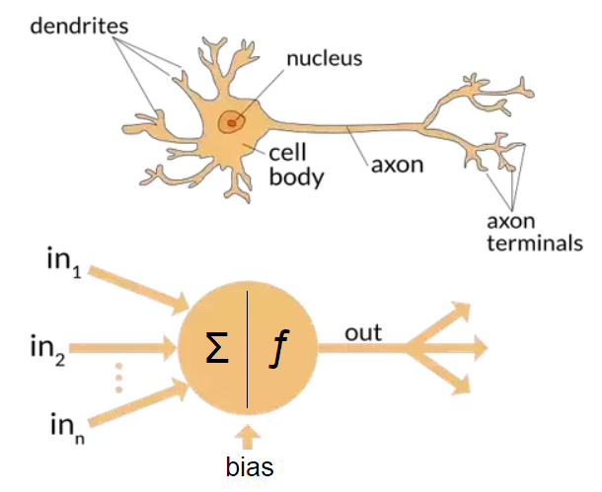
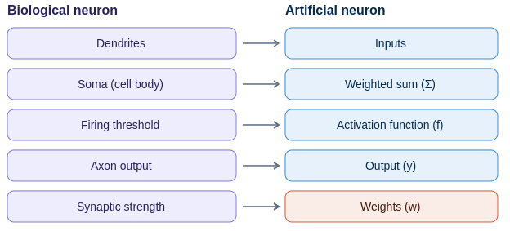
SECTION 1 · NEURAL NETWORKS
What Is a Neural Network?
A Neural Network is a computing system inspired by how biological neuron process information.
Biological neurons:
Receive signals through dendrites
Process the signal in the cell body
Fire an output via the axon if a threshold is crossed
UNIT 1 · INTRODUCTION TO DEEP LEARNING
6

Slide 16
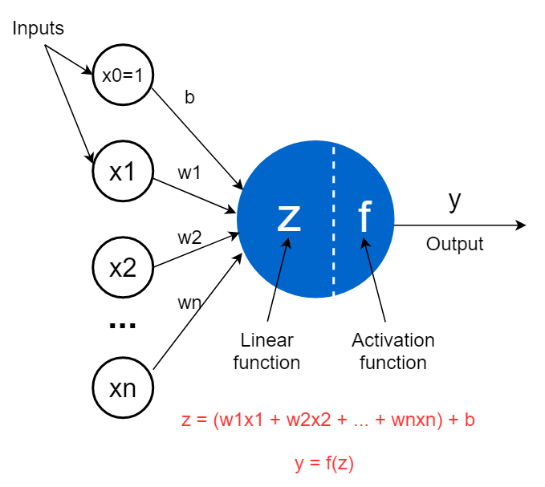
SECTION 1 · NEURAL NETWORKS
The Artificial Neuron (Perceptron)
UNIT 1 · INTRODUCTION TO DEEP LEARNING
7

Slide 17
SECTION 1 · NEURAL NETWORKS
The Artificial Neuron (Perceptron)
Mathematical Model
Why Activation Functions Matter
z = (w1·x1 + w2·x2 + … + wn·xn) + b
Without an activation function, stacking layers is mathematically equivalent to a single linear layer — the network could only learn straight-line relationships.
y = f(z)
xi — input features
wi — weight (importance of input i)
b — bias (shifts the decision boundary)
f — activation function (Sigmoid, ReLU, Tanh)
y — neuron's output
Non-linear activations let networks model curved, complex decision boundaries — essential for images, speech and language.
Common choices: Sigmoid (0–1 probabilities), Tanh (−1 to 1), ReLU (fast, default for hidden layers), Softmax (multi-class output).
UNIT 1 · INTRODUCTION TO DEEP LEARNING
7

Slide 18
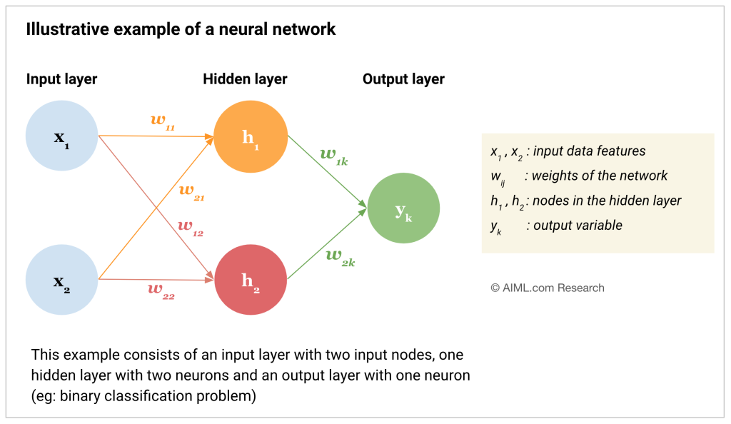

SECTION 1 · NEURAL NETWORKS
From a Single Neuron to a Network (ANN)
An Artificial Neural Network (ANN) connects many neurons in layers. Each layer transforms the data a little more, building up the ability to represent complex patterns.
UNIT 1 · INTRODUCTION TO DEEP LEARNING
8

Slide 19
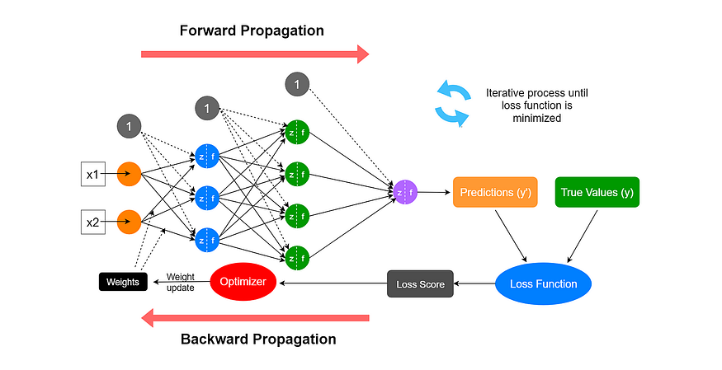
SECTION 1 · NEURAL NETWORKS
How Does an ANN Learn?
UNIT 1 · INTRODUCTION TO DEEP LEARNING
10

Slide 20
SECTION 1 · NEURAL NETWORKS
How Does an ANN Learn?
1
Forward Pass
Input data flows through the network; each neuron computes a weighted sum + activation, producing a prediction.
2
Loss Calculation
A loss function measures how far the prediction is from the true label (e.g., cross-entropy, MSE).
3
Backpropagation
The error is propagated backward, computing how much each weight contributed to the mistake.
4
Weight Update
Gradient Descent nudges every weight slightly to reduce the loss; the cycle repeats for many epochs.
UNIT 1 · INTRODUCTION TO DEEP LEARNING
10

Slide 21
03
Brief History of AI
From Alan Turing's 1950 question to today's Generative AI

Slide 22
SECTION 3 · HISTORY OF AI
The Early Decades: Birth & Winters (1950–1993)
1950
1974–80
Alan Turing asks “Can machines think?” and proposes the Turing Test.
First AI Winter — funding declines as computing power and results fall short of expectations.
1956
1980–87
John McCarthy coins the term “Artificial Intelligence” at the Dartmouth Conference.
Expert Systems flourish (e.g., medical diagnosis systems).
1960s–70s
1987–93
Rule-based, symbolic AI systems gain popularity.
Second AI Winter.
UNIT 1 · INTRODUCTION TO DEEP LEARNING
16

Slide 23
SECTION 3 · HISTORY OF AI
The Modern Era: From Deep Blue to Generative AI
1997
2022–Present
IBM Deep Blue defeats world chess champion Garry Kasparov.
Generative AI revolution: ChatGPT, Gemini, Claude, Midjourney.
2012
2025+
AlexNet wins ImageNet — the Deep Learning revolution begins.
Multimodal and Agentic AI — systems that see, reason and act.
2016
DeepMind's AlphaGo defeats Go champion Lee Sedol.
UNIT 1 · INTRODUCTION TO DEEP LEARNING
17

Slide 24
SECTION 3 · HISTORY OF AI
Timeline at a Glance
1950
1974
2012
2022
Turing
Test
AI
Winter
AlexNet
ChatGPT
1956
1997
2016
2026
Dartmouth
Conference
Deep
Blue
AlphaGo
Agentic
AI
Notice the pattern: hype → unmet expectations → “winter” → breakthrough. Deep Learning's 2012 breakthrough finally broke this cycle thanks to data, compute and algorithms aligning together.
UNIT 1 · INTRODUCTION TO DEEP LEARNING
18

Slide 25
04
DL Successes — The Last Decade
Landmark breakthroughs that proved Deep Learning works at scale

Slide 26
SECTION 4 · SUCCESSES
Case Study — AlexNet & ImageNet (2012)
The Challenge
Classify 1.2 million images into 1000 categories — the annual ImageNet (ILSVRC) competition.
The Breakthrough
Krizhevsky, Sutskever & Hinton's AlexNet, a deep Convolutional Neural Network trained on GPUs, slashed the error rate from ~26% to ~15%.
The Impact
Proved that deep networks + GPUs + large data beat hand-engineered features — triggering the modern Deep Learning boom.
Top-5 Error Rate
26%
15%
3.6%
2011
(classical)
2012
AlexNet
2015
ResNet
UNIT 1 · INTRODUCTION TO DEEP LEARNING
20

Slide 27
SECTION 4 · SUCCESSES
Case Studies — AlphaGo (2016) & ChatGPT (2022)
AlphaGo (DeepMind, 2016)
ChatGPT & Generative AI (2022–)
Go has more possible positions than atoms in the universe — brute force is impossible.
Combined deep neural networks with reinforcement learning and tree search.
Defeated 18-time world champion Lee Sedol 4–1, decades ahead of expert predictions.
Large Language Models, trained on internet-scale text with the Transformer architecture, learn to generate fluent, context-aware language.
Reached 100 million users within two months of launch — the fastest-adopted consumer application in history.
Sparked the wider Generative AI wave: Gemini, Claude, Midjourney, and beyond.
UNIT 1 · INTRODUCTION TO DEEP LEARNING
21

Slide 28
05
Reasons to Go Deep
Why now? Four forces that made Deep Learning practical

Slide 29
SECTION 5 · REASONS TO GO DEEP
Four Forces Behind the Deep Learning Boom
1
Data
2
Compute
Explosion of labelled data — ImageNet, web text, sensors, smartphones — gives networks enough examples to learn from.
GPUs (and later TPUs) made the massive matrix multiplications of deep networks fast and affordable.
3
Algorithms
4
Automatic Features
ReLU activations, Dropout, Batch Normalization, residual connections and the Transformer made very deep networks trainable.
Networks learn their own features from raw data, removing the bottleneck of manual feature engineering.
UNIT 1 · INTRODUCTION TO DEEP LEARNING
23

Slide 30
CPU vs GPU vs TPU
Why parallel hardware is the engine behind deep learning

Slide 31



CPU vs GPU: Architecture
Two very different designs for two very different jobs
CPU (Central Processing Unit)
GPU (Graphics Processing Unit)
4–64 powerful cores, optimized for low-latency, sequential logic
High clock speed (~3–5 GHz) per core
Large per-core cache; complex branch prediction
MIMD-style: each core runs a different instruction stream
Best at: control flow, I/O, diverse general-purpose tasks
Thousands of small cores (e.g., 10,000+ CUDA cores)
Lower clock speed, but massive SIMT parallelism
Very high memory bandwidth (~1–3 TB/s HBM)
SIMD/SIMT: same instruction, thousands of data lanes at once
Best at: throughput on repetitive, parallel math
Why deep learning needs GPUs
Training a neural network is dominated by matrix multiplications and convolutions — millions of independent multiply-accumulate operations per layer. GPUs run the same operation across thousands of cores simultaneously and use high-bandwidth memory to keep those cores fed, giving 10–100x speedups over CPUs. Tensor Cores further accelerate mixed-precision matmuls used in training.

Slide 32
06
Applications of Deep Learning
Where these techniques are changing industries today

Slide 33
SECTION 6 · APPLICATIONS
Healthcare, Finance & Education
H
$
E
Healthcare
Banking & Finance
Education
CNNs detect tumours, fractures and diabetic retinopathy from medical scans, often matching specialist accuracy.
Deep models flag fraudulent transactions in real time by learning subtle, evolving patterns of misuse.
Adaptive learning platforms personalise content and pace using a student's own performance data.
Case study: a hospital receiving 50,000 X-rays/day uses DL to flag suspicious scans for radiologists — assisting, not replacing, doctors.
Case study: card networks use sequence models to score every transaction in milliseconds.
Case study: recommendation engines suggest the next topic or question based on mastery level.
UNIT 1 · INTRODUCTION TO DEEP LEARNING
25

Slide 34
SECTION 6 · APPLICATIONS
Vision, Language & Everyday Life
V
L
★
Computer Vision
NLP & Chatbots
Entertainment
Self-driving cars use CNNs to detect lanes, pedestrians and obstacles from camera and LiDAR feeds.
Transformer-based language models understand and generate human language for translation, search and assistants.
Recommender systems learn viewing/listening patterns to personalise content feeds.
Case study: Tesla / Waymo perception stacks run multiple deep networks per frame, 30+ times a second.
Case study: ChatGPT, Google Translate and voice assistants like Alexa and Siri.
Case study: Netflix, Spotify and YouTube recommendation engines.
UNIT 1 · INTRODUCTION TO DEEP LEARNING
26

Slide 35
07
Challenges of Deep Learning
Deep Learning is powerful — but not free of serious limitations

Slide 36
SECTION 7 · CHALLENGES
Key Limitations to Be Aware Of
Data Hungry
Computationally Expensive
Black-Box Nature
Deep networks typically need thousands to millions of labelled examples; performance degrades sharply with small datasets.
Training large models requires powerful GPUs/TPUs, significant time and substantial energy consumption.
Predictions are hard to interpret — this is the core motivation for Explainable AI (XAI) techniques like Grad-CAM and SHAP.
Overfitting & Bias
Adversarial Vulnerability
Lacks True Understanding
Models can memorise training data or inherit and amplify biases present in it, hurting generalisation and fairness.
Small, imperceptible input perturbations can fool deep networks into confident, wrong predictions.
Deep Learning finds statistical patterns; it does not possess genuine reasoning or consciousness.
UNIT 1 · INTRODUCTION TO DEEP LEARNING
29

Slide 37
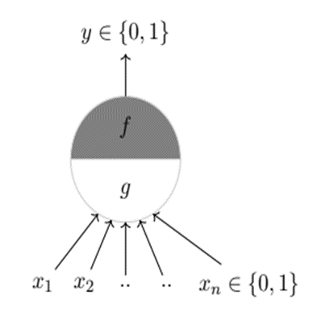
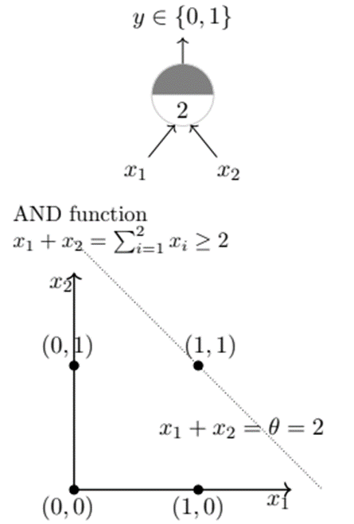
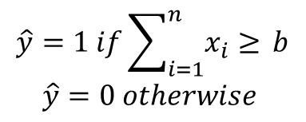
McCulloch Pit’s Neuron (MP Neuron)

Slide 38
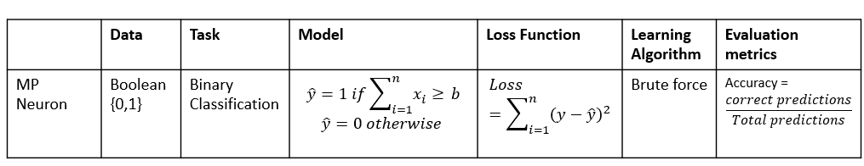
Six Jars for MP Neuron

Slide 39
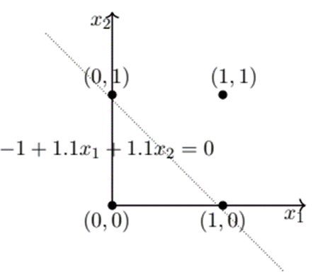
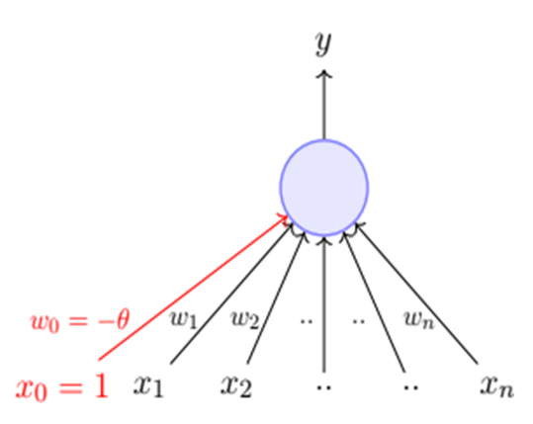
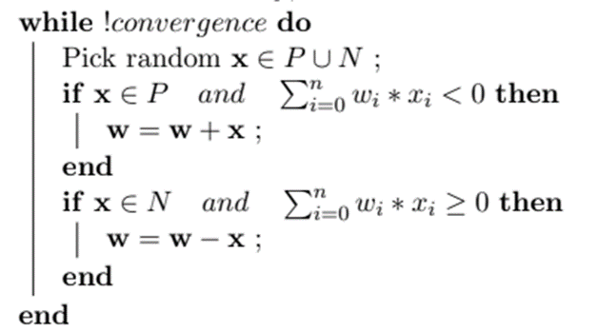
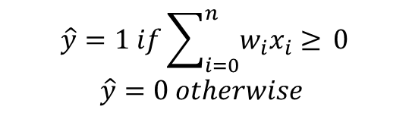


Perceptron
$$y∈\{0,1\}$$
$$X∈R$$

Slide 40
WRAP-UP
Unit 1 Summary
Neural Networks are inspired by biological neurons; ANNs stack layers of these neurons to learn complex functions.
Deep Learning automatically learns hierarchical features from raw data, removing the need for manual feature engineering.
AI's history (1950–today) shows cycles of hype and “winters” — broken in 2012 by the convergence of data, compute and algorithms.
Landmark successes — AlexNet, AlphaGo, ChatGPT — demonstrate Deep Learning's real-world impact.
Deep Learning powers healthcare, finance, vision, language and entertainment applications — but remains data-hungry, costly and often a “black box.”
UNIT 1 · INTRODUCTION TO DEEP LEARNING
30

Slide 41
Thank You
Questions & Discussion | Next: Unit 2 — Perceptrons, Activation Functions & Training Deep Networks

